Slide 1

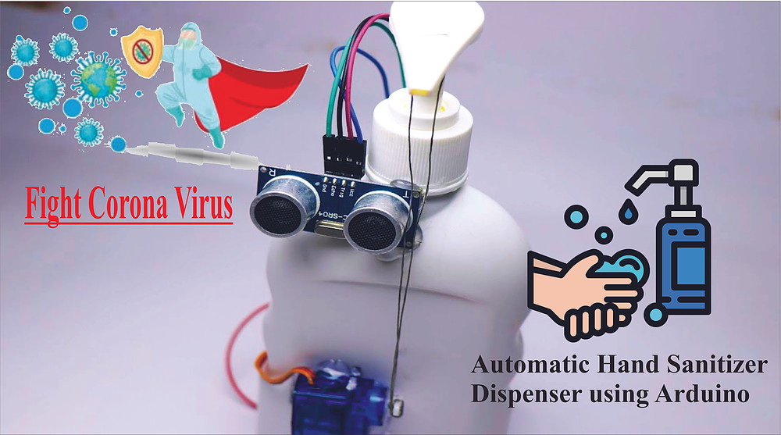
Automatic Hand Sanitizer
Switching Theory Mini-Project
Submitted to: -
Jimson Mathew sir
Submitted By: -
Tarusi Mittal
1901CS65

Slide 2
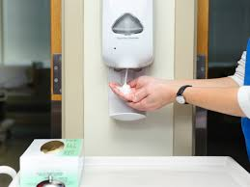
INDEX
1. Overview
2. Components required
3. Setup
4. Working Principle
5. Code Snippets & Explanation
6. Conclusion and future scope

Slide 3
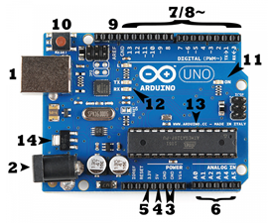
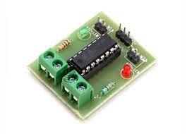
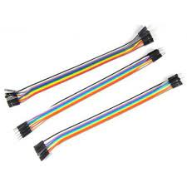
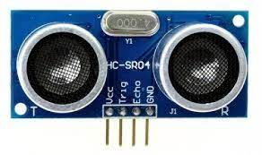
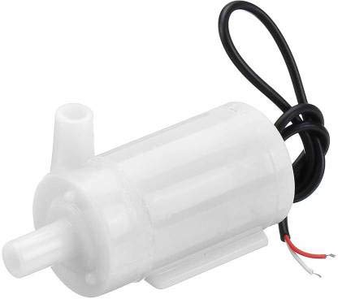
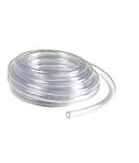
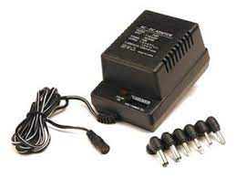
Components Required
1. Arduino uno
2. l293d motor driver
3. Ultrasonic Sensor -HC-SR04(Generic)
4. Jumper wires(m-m, m-f, f-f)
5. Water Pump DC 5V to 12V Submersible Motor Pump
6. Ac-dc Convertor
7. Pipe

Slide 4
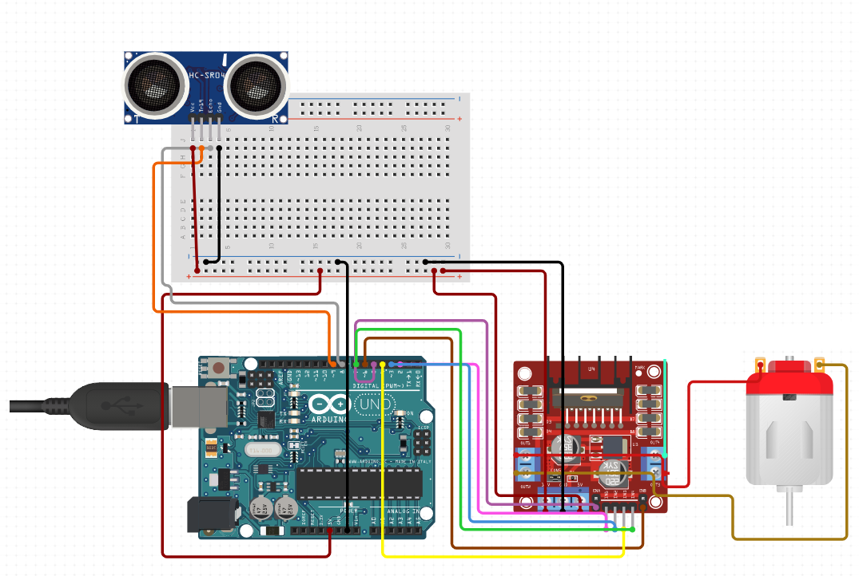
Setup
Motion sensor
Breadboard
Arduino UNO
l293d motor driver
Water Pump

Slide 5
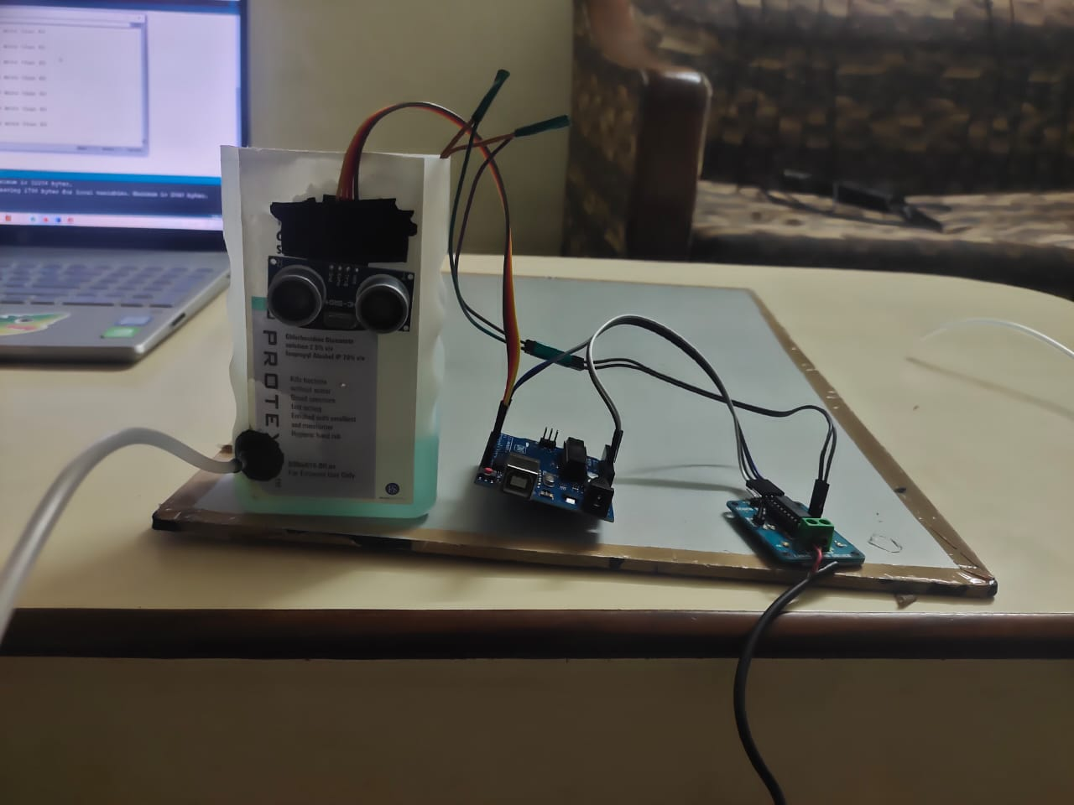
Initial Setup
Arduino Board
Ultrasonic Sensor
Motor Driver
Pipe

Slide 6
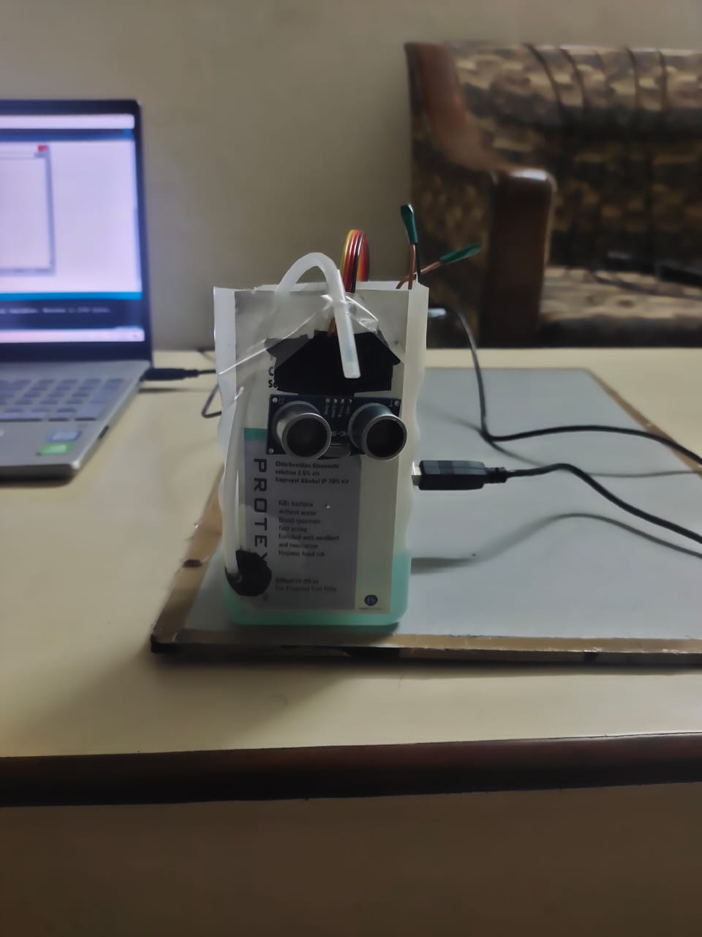
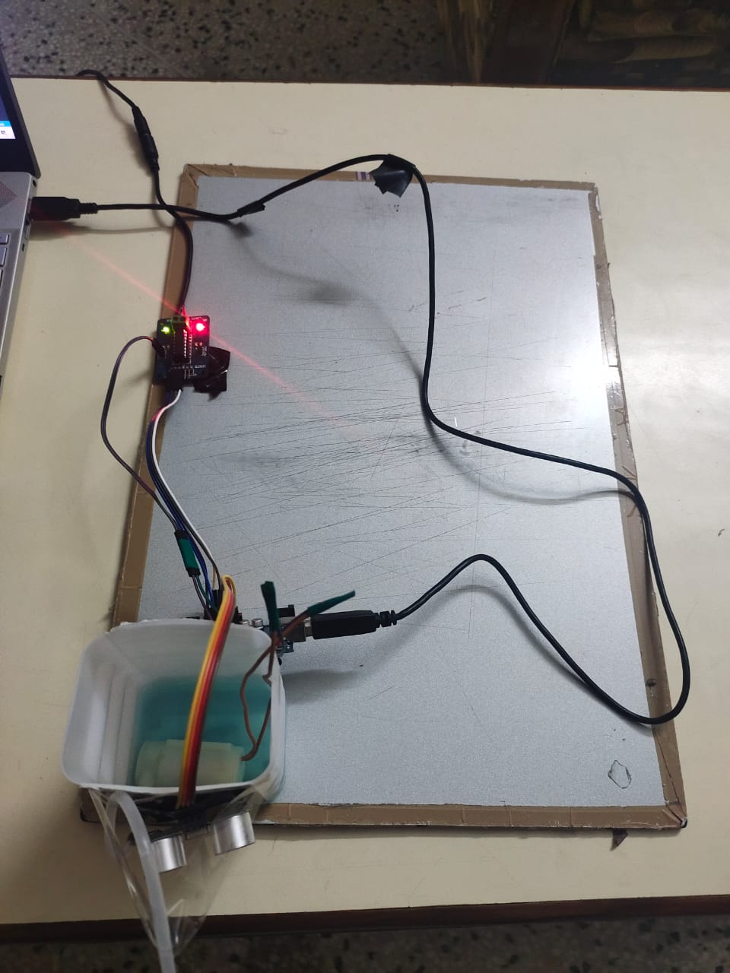
Final Setup
Front View
Top View

Slide 7
Working Principle
Pumps Out sanitizer
Pump
Motor Driver switches off
After 1 sec
On
if d<10
Ultrasonic Sensor
Arduino Uno Board
Motor Driver
Distance>10cm
Distance<10cm

Slide 8
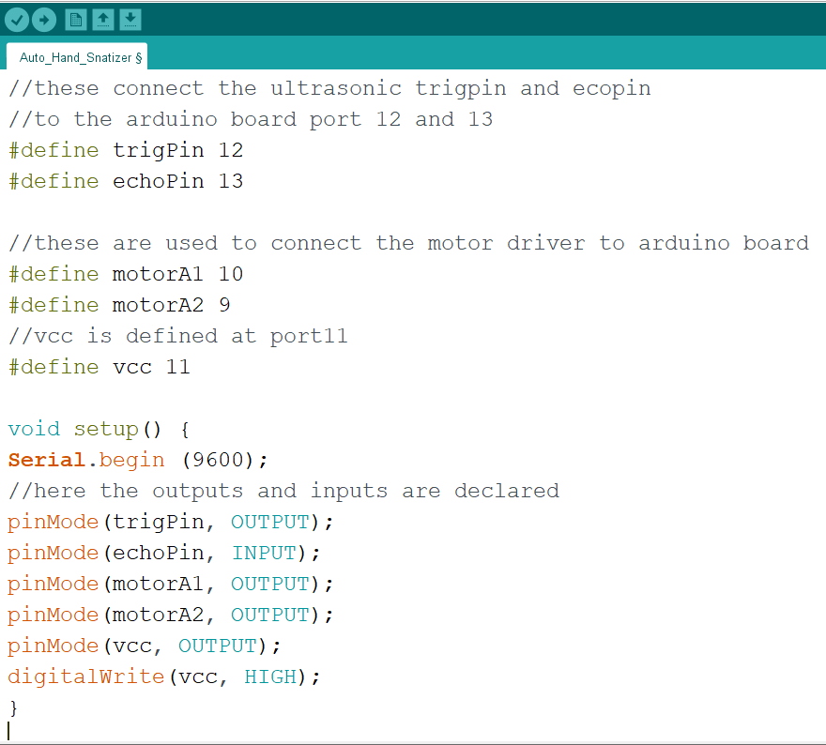
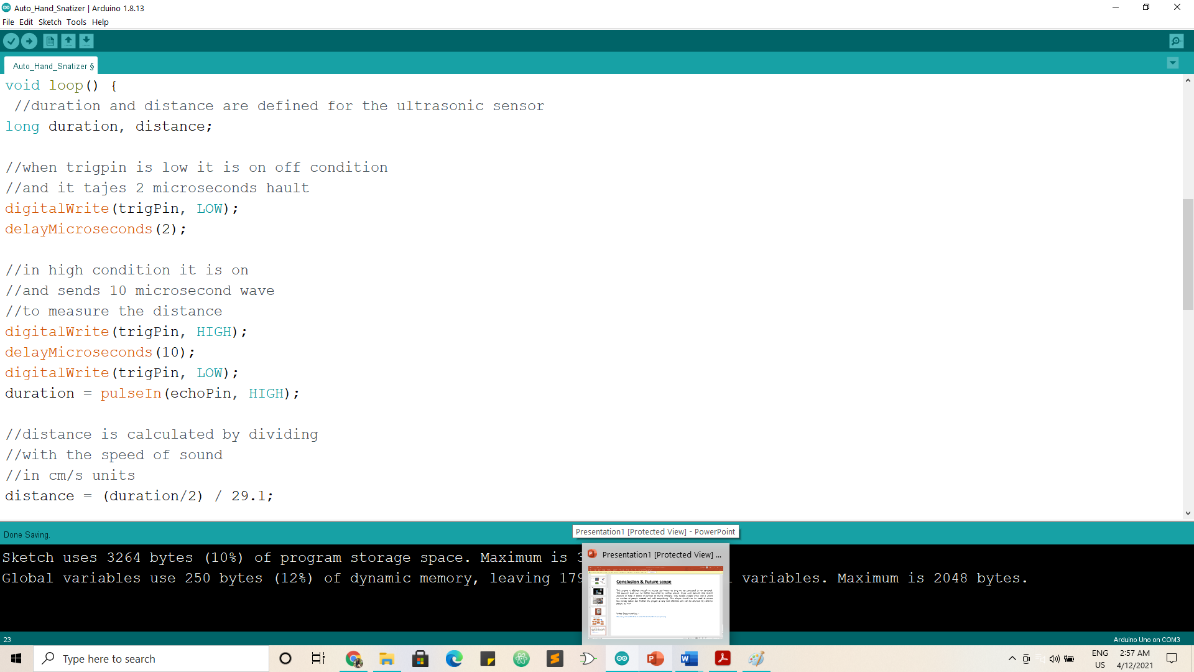
Code Snippets

Slide 9
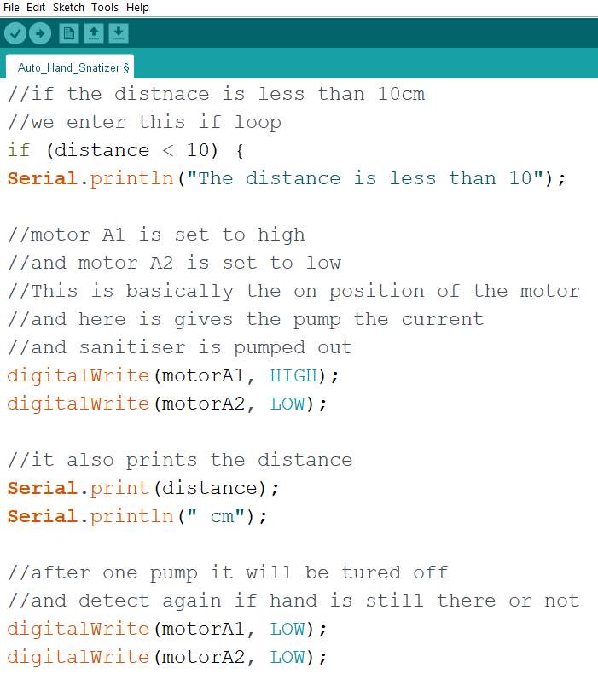
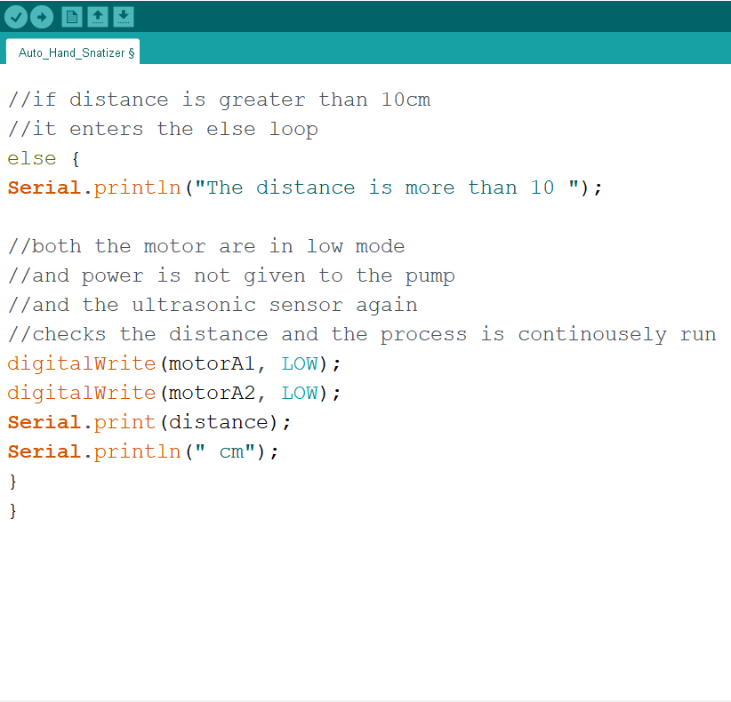
Code Snippets

Slide 10
Conclusion And Future Scope
This project is made by keeping in mind the current situation of the world. So as to minimize the contact between people this project can be installed in public places to ensure proper sanitization. The project can be further extended by installing a simple led which indicates if the sanitizer bottle is less than 20 percent left and needs refilling.
Here is the video demonstration of the project:
https://drive.google.com/file/d/15psNiFYlDrfyiH77cew7qLd-3_noKf9N/view?usp=drivesdk

Slide 11

References
https://technicalromboz.com
https://www.instructables.com/
https://www.circuito.io/
https://forum.arduino.cc/
https://www.youtube.com/watch?v=sxqBbkhozYM
https://maker.pro/arduino/tutorial/how-to-connect-an-ultrasonic-sensor-to-an-arduino

